Slide 1
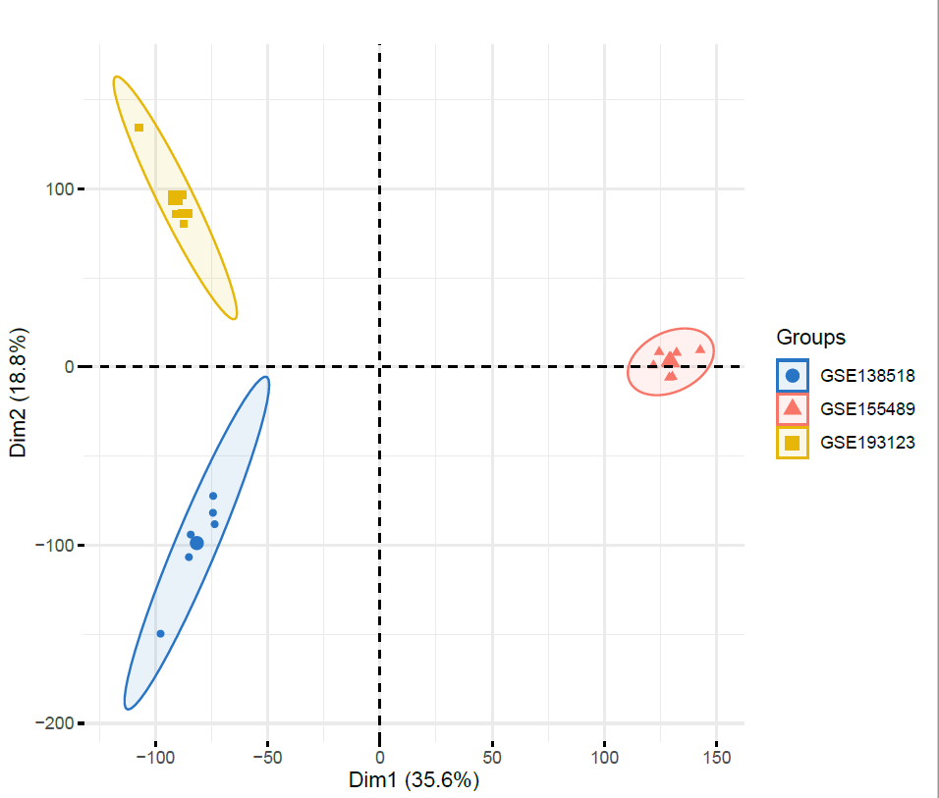
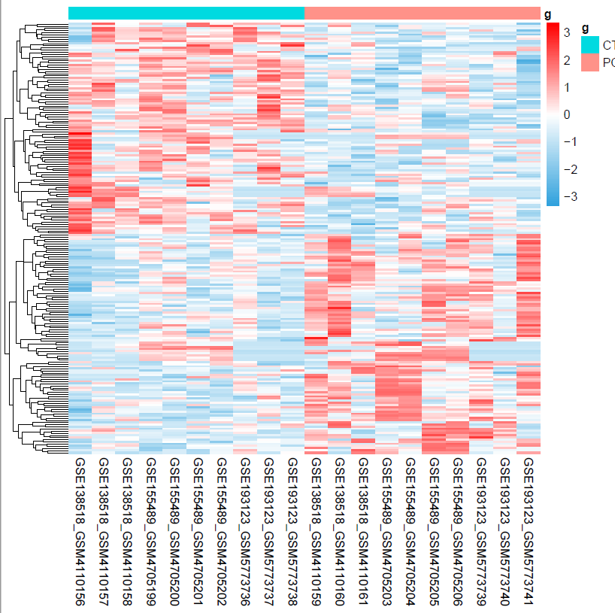
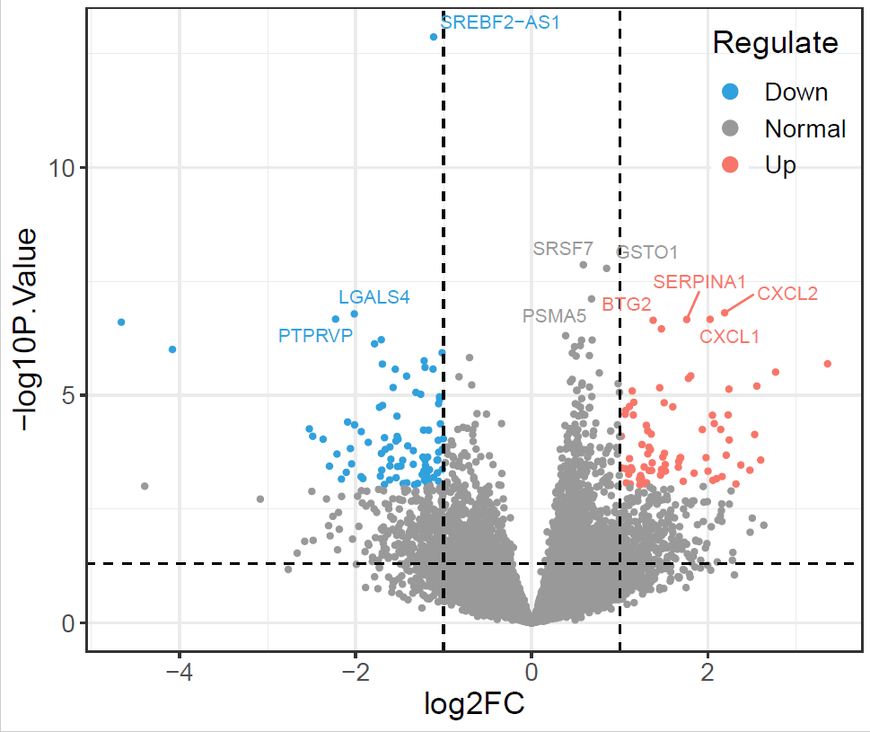
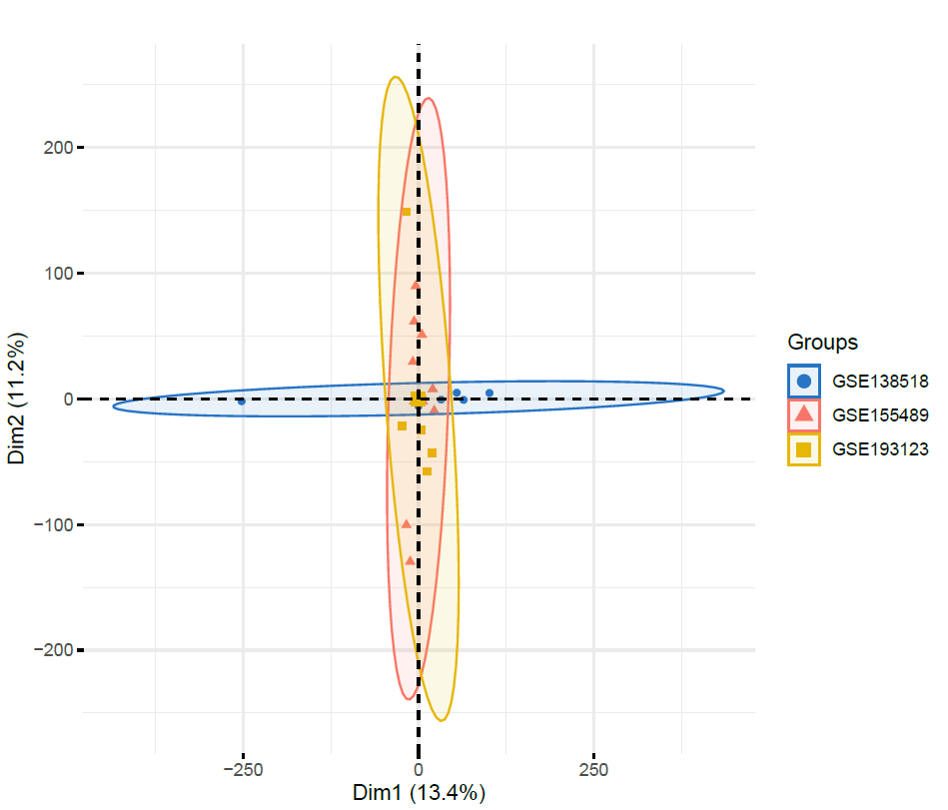
Figure 1
Notes:
展示deg的状况

Slide 2
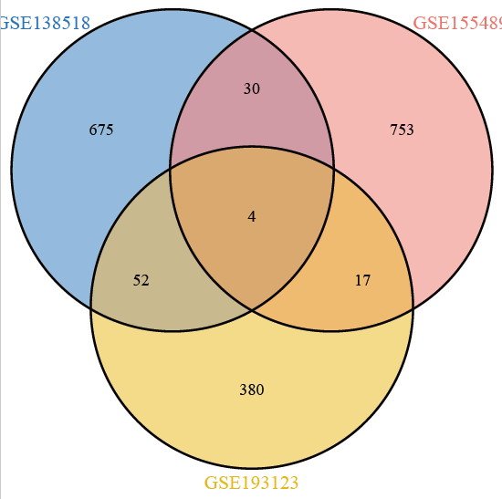
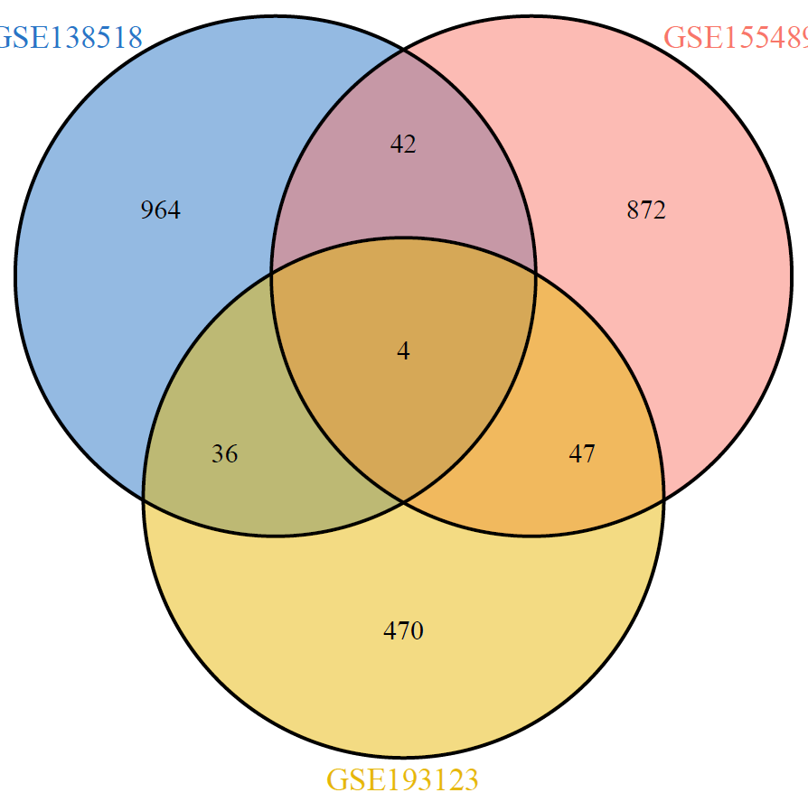
Figure 1 - supplementary
A 三个基因集的韦恩图 up and down
"DUSP2" "SERPINA1" "CXCL2" "ICAM3"
"TSHZ2" "AKAP5" "SREBF2-AS1" "PNMA8B"
Notes:
up and down

Slide 3
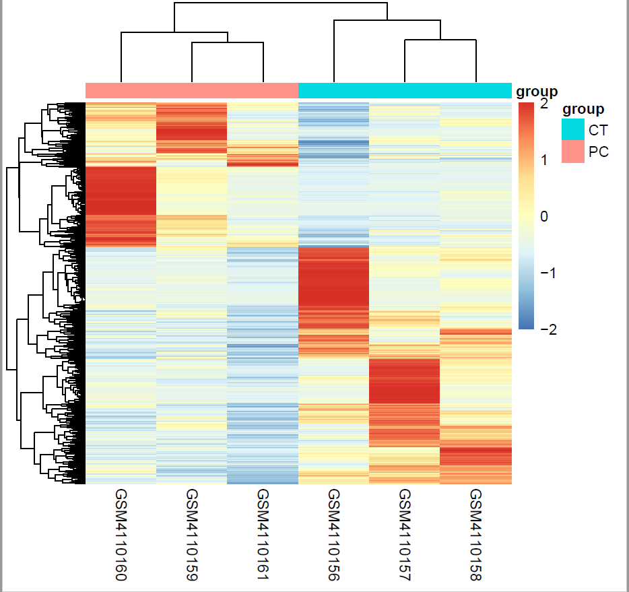
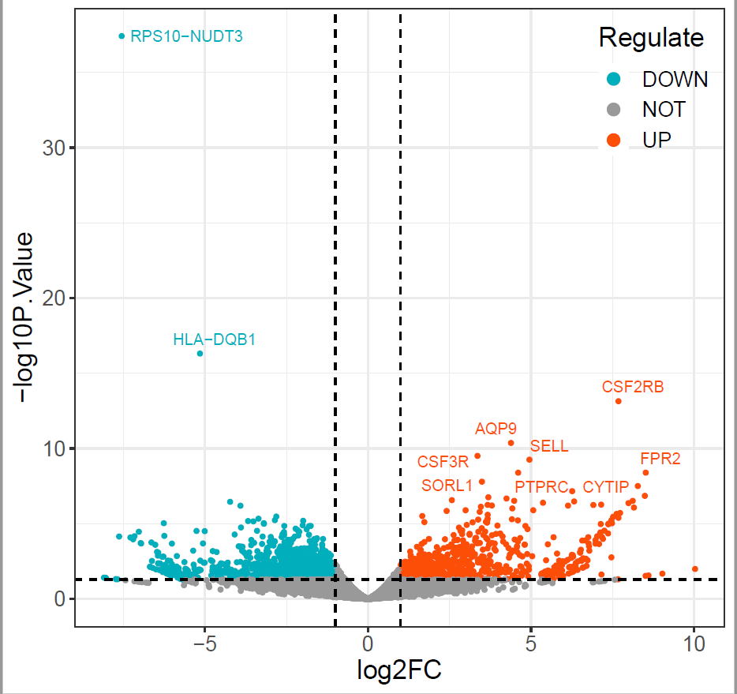
Figure 1 - supplementary
Notes:
这是第一个数据库的差异基因的热图和火山图

Slide 4
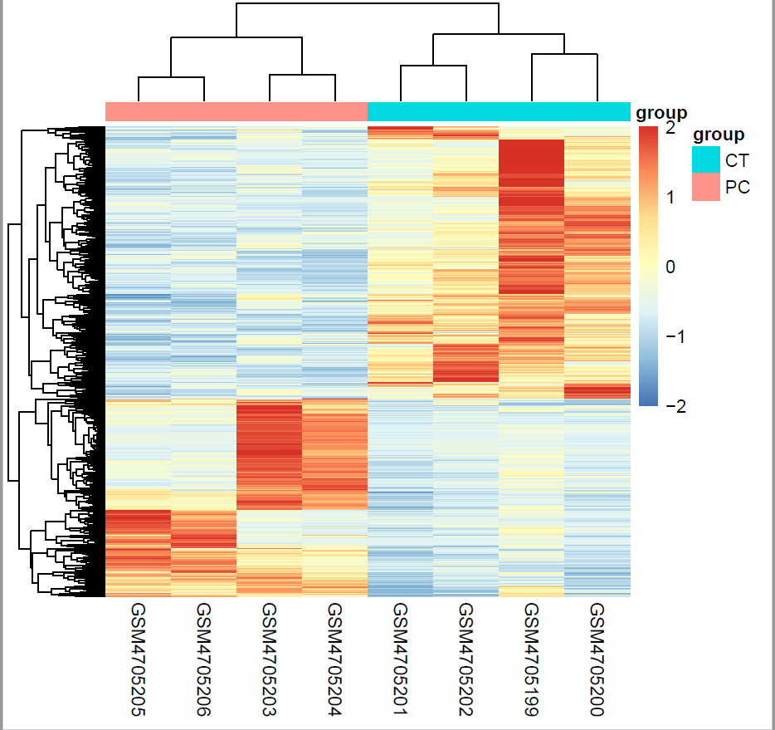
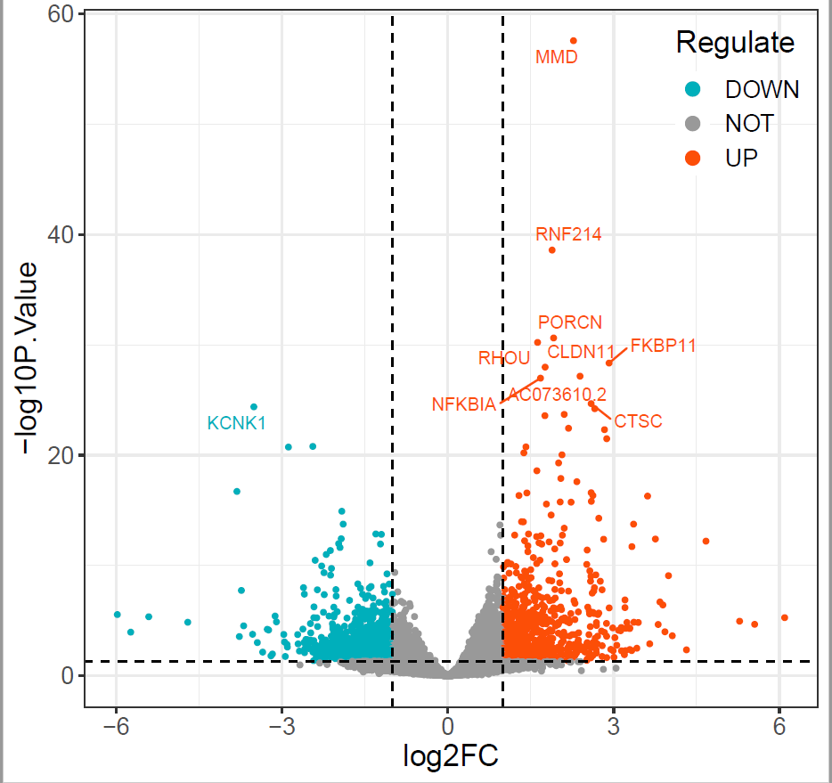
Figure 1 - supplementary
Notes:
第二个数据库的差异基因和火山图

Slide 5
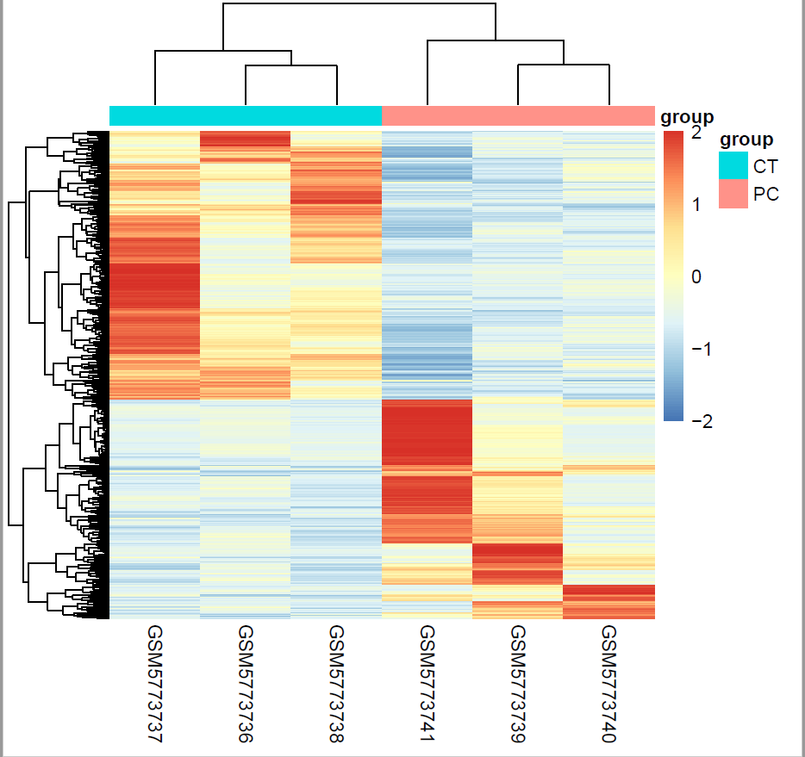
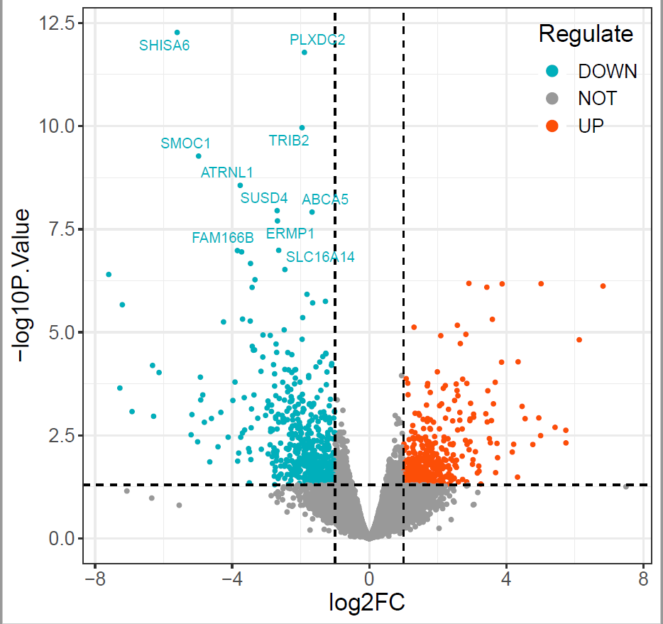
Figure 1 - supplementary
Notes:
第三个数据库的差异基因和火山图

Slide 6
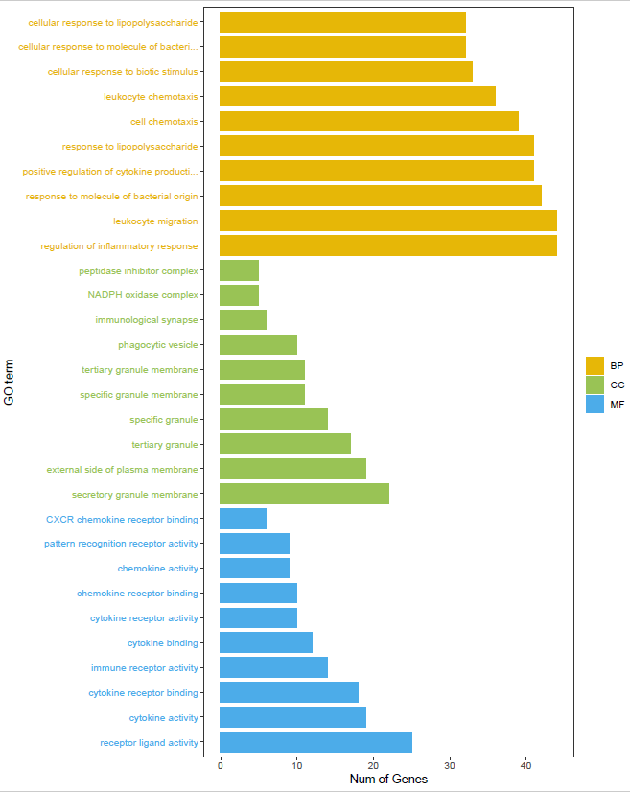
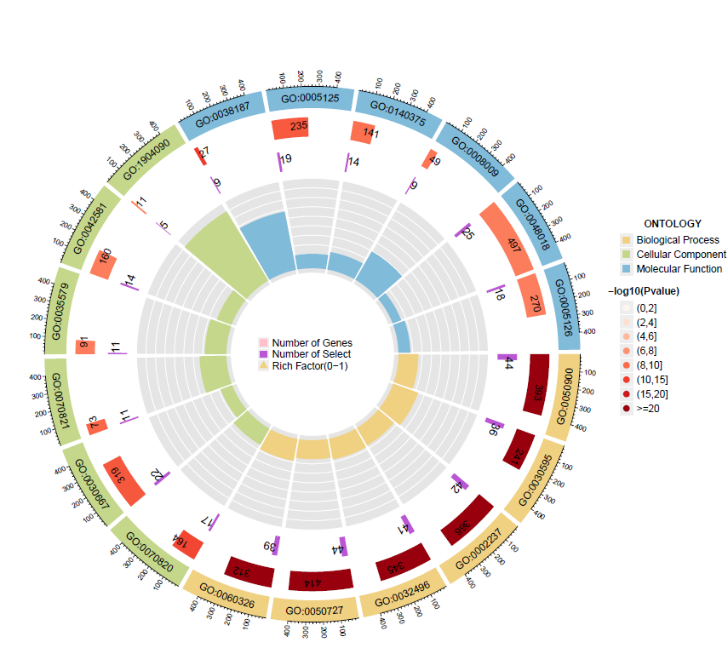
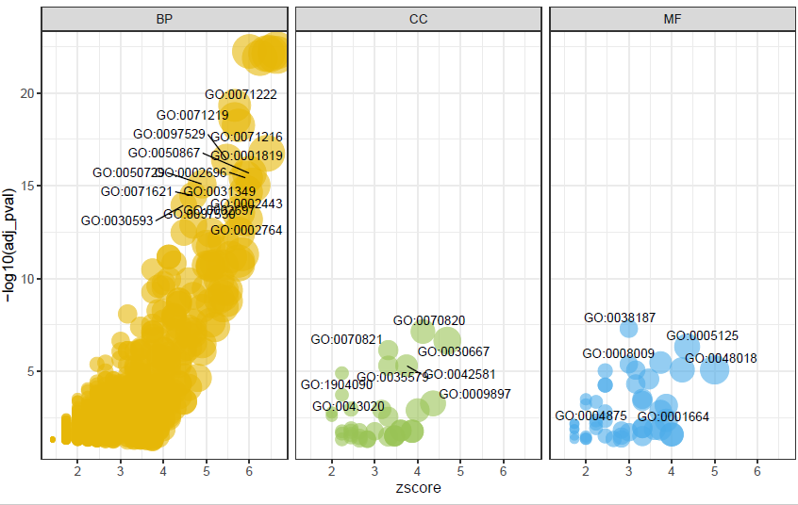
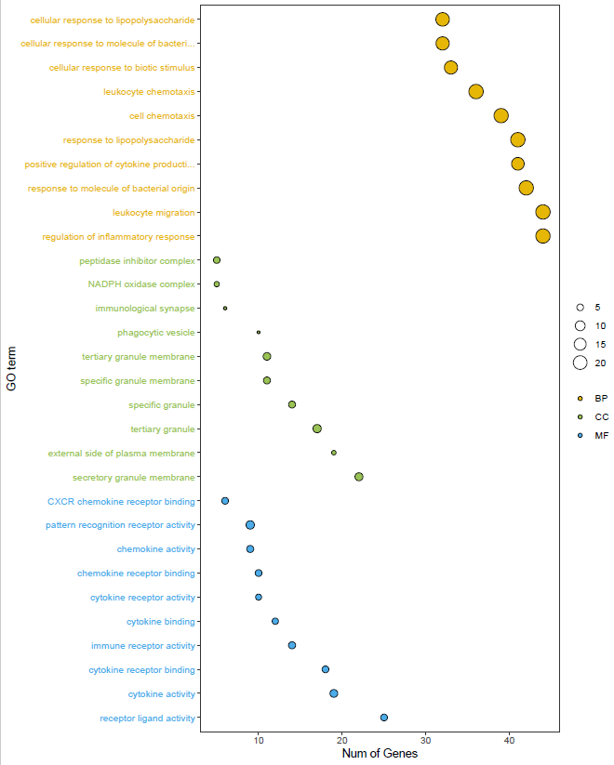
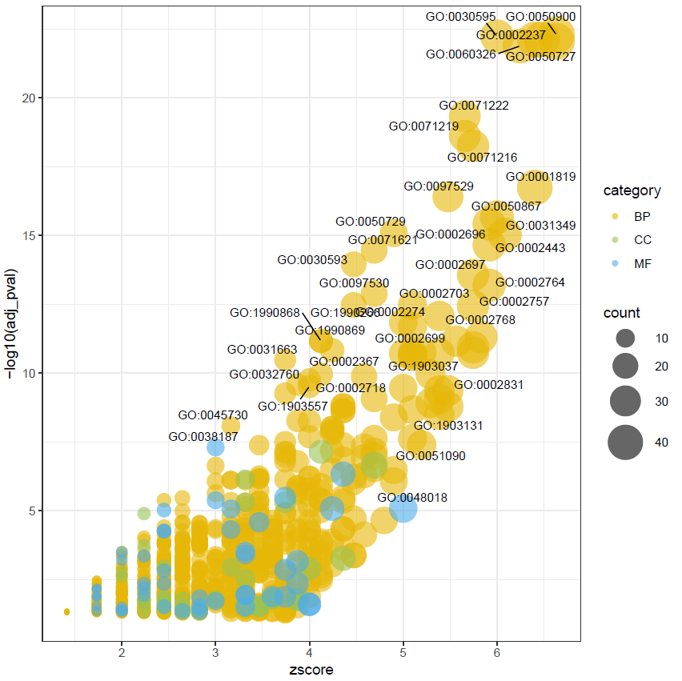
Figure 2
UP
Notes:
炎症、免疫、凋亡（自噬？）
regulation of inflammatoray response
leukocyte migration
response to molecule of bacterial origin
response to lipopolysaccharide
cell chemotaxis
leukocyte chemotaxis
cellular response to biotic stimulus
peptidase inhibitor complex
NADPH oxidase complex
immunological synapse
phagocytic vesicle
tertiary granule membrane
specific granule membrane
CXCR chemokine receptor binding
pattern recognition receptor activity
chemokine activity
chemokine receptor binding
immune receptor activity

Slide 7
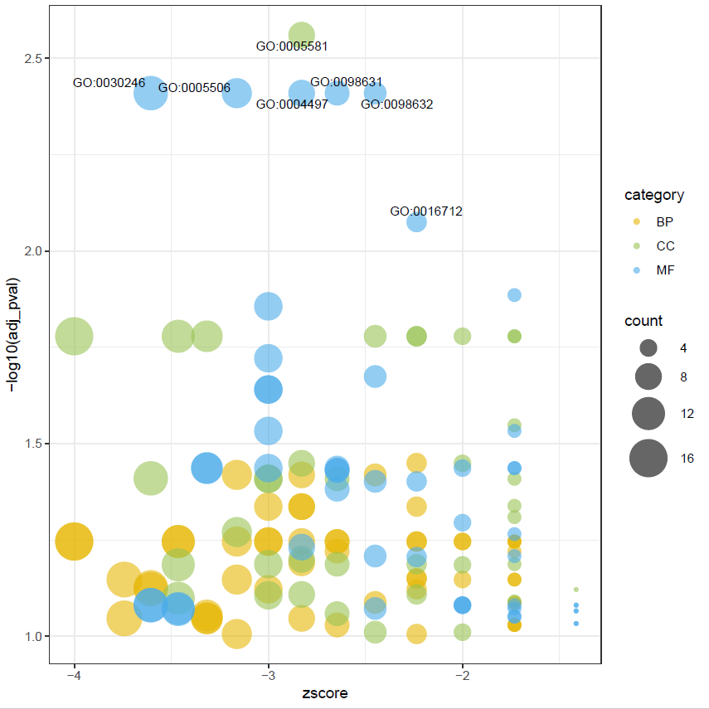
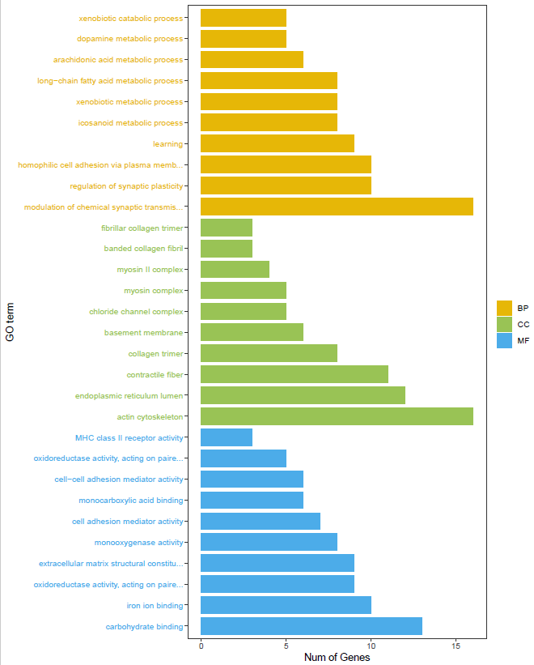
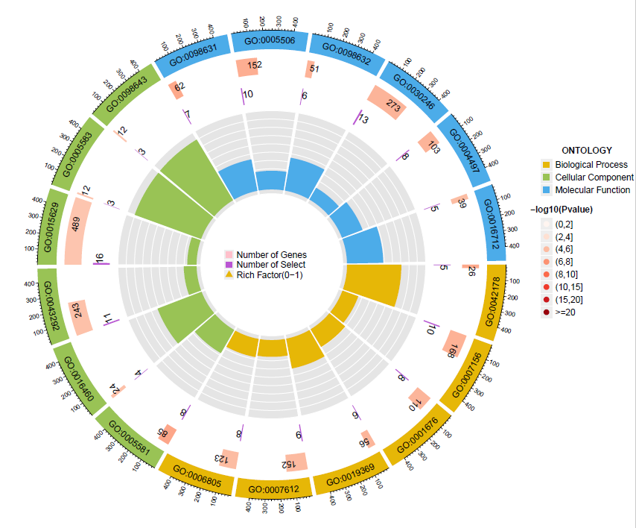
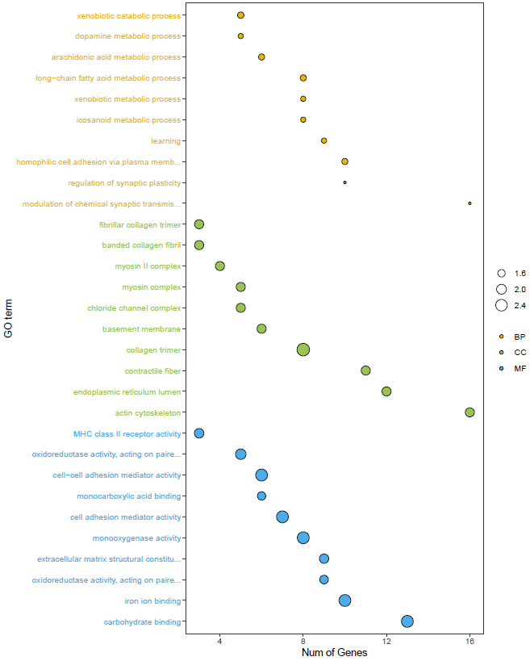
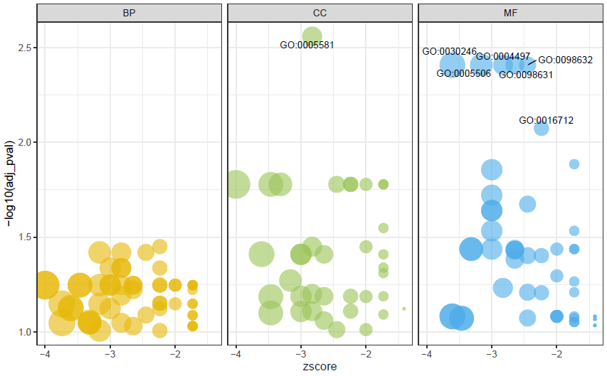
Figure 2
DOWN
Notes:
xenobiotic catabolic process
dopamine metabolic process
long-chain fatty acid metabolic process
regulation of synaptic plasticity
fibrillar collagen trimer
myosin
chloride channel complex
actin cytoskeleton
endoplasmic reticulum lumen
MHC class ii receptor activity
cell-cell adhesion mediator activity
cell adhsion mediator activity
monooxygenase acticity
extracellular matrix structural constitution
iron ion binding
carbohydrate binding

Slide 8
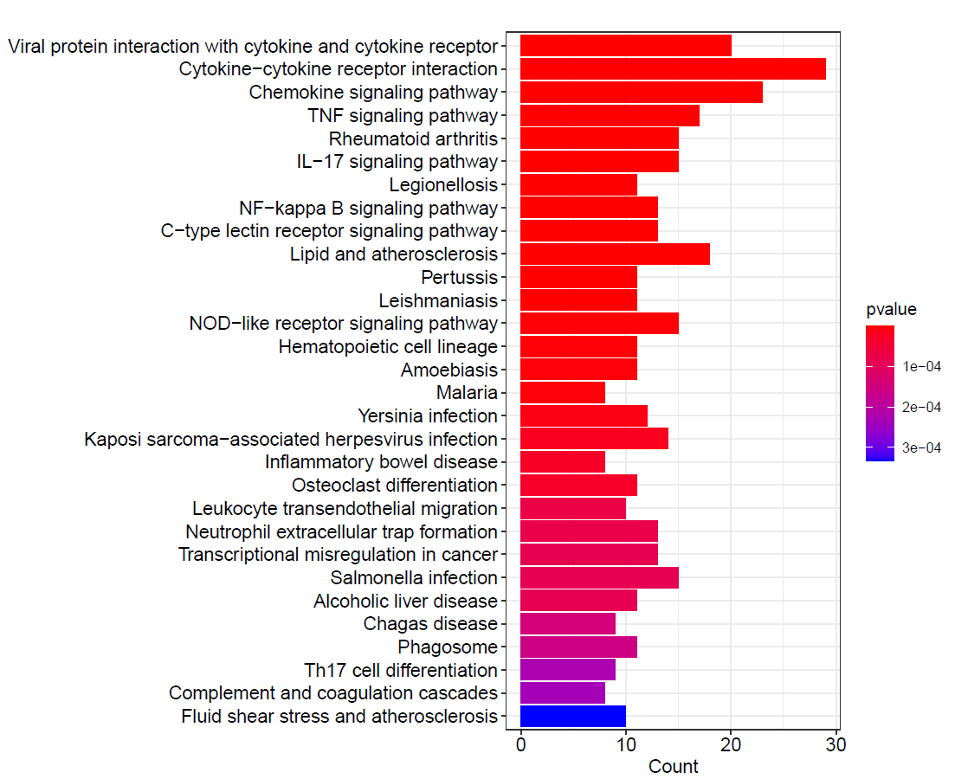
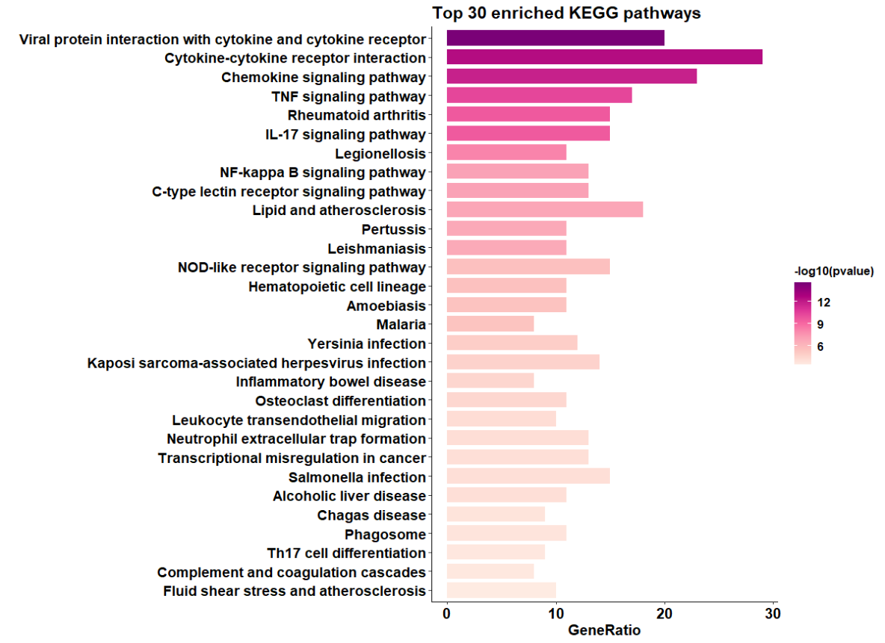
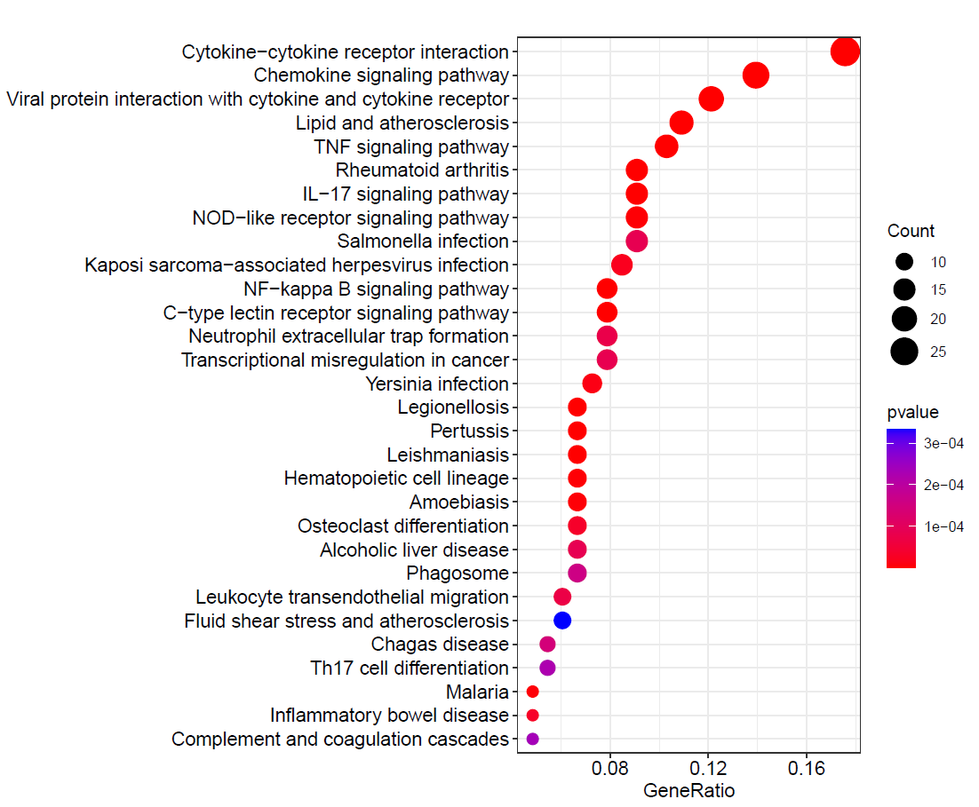
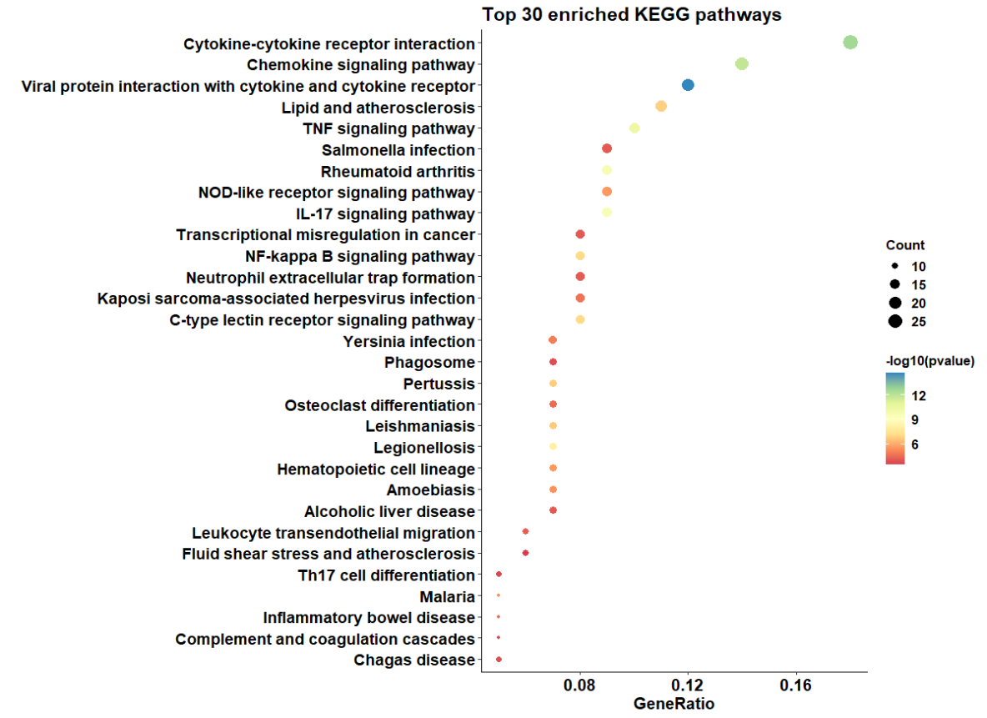
A GO分析
B KEGG的图
Figure 2
UP
Notes:
Go和KEGG的csv文件发我， 图重新调整。

Slide 9
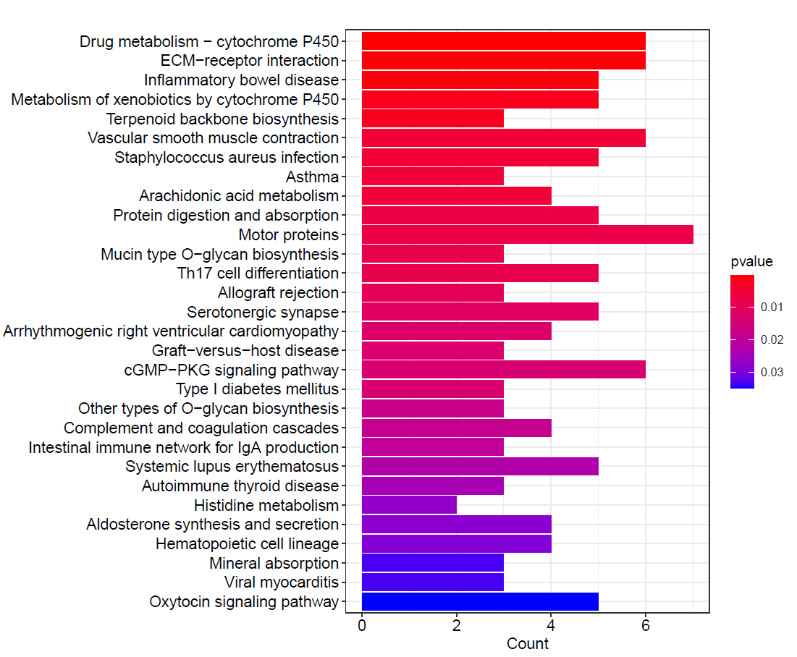
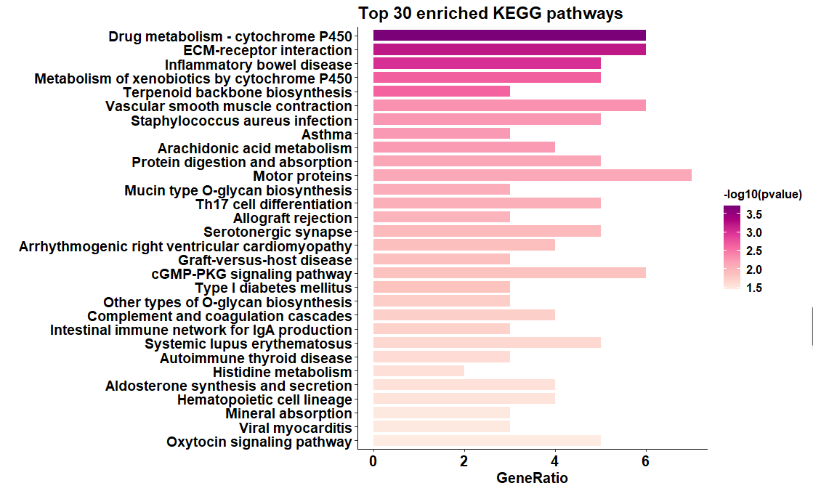
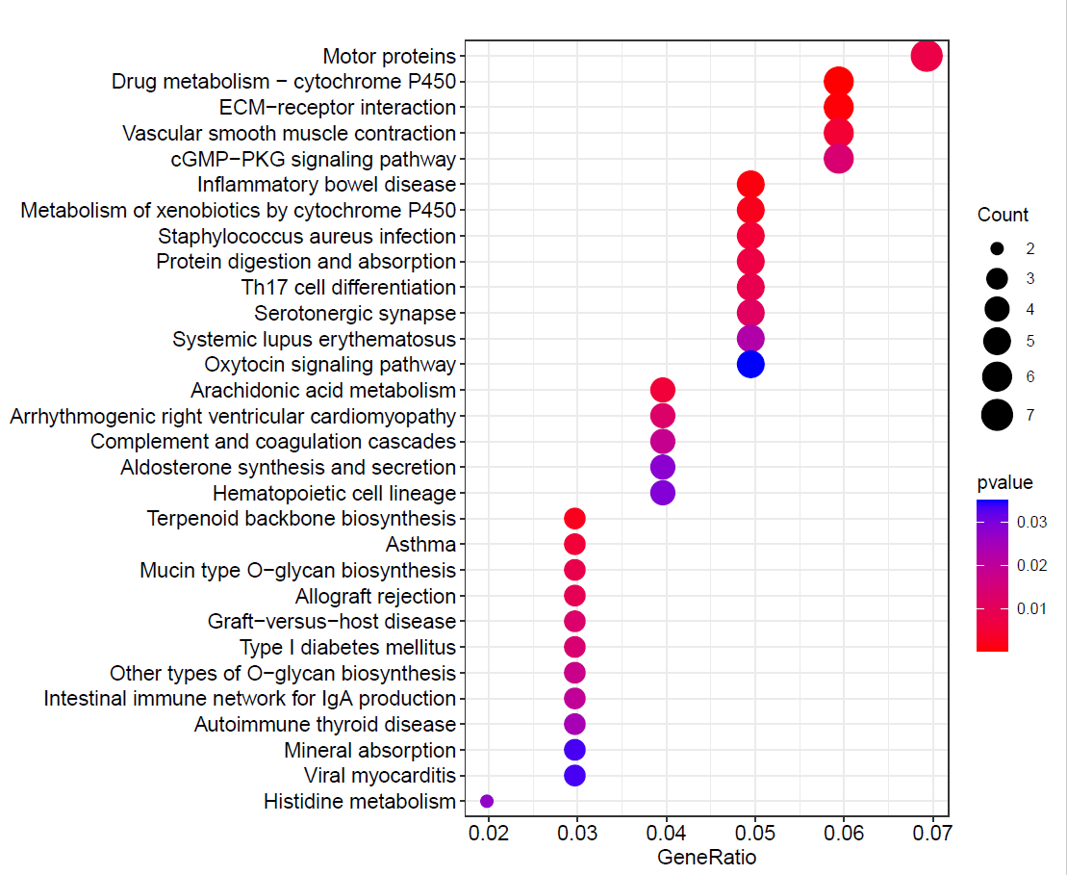
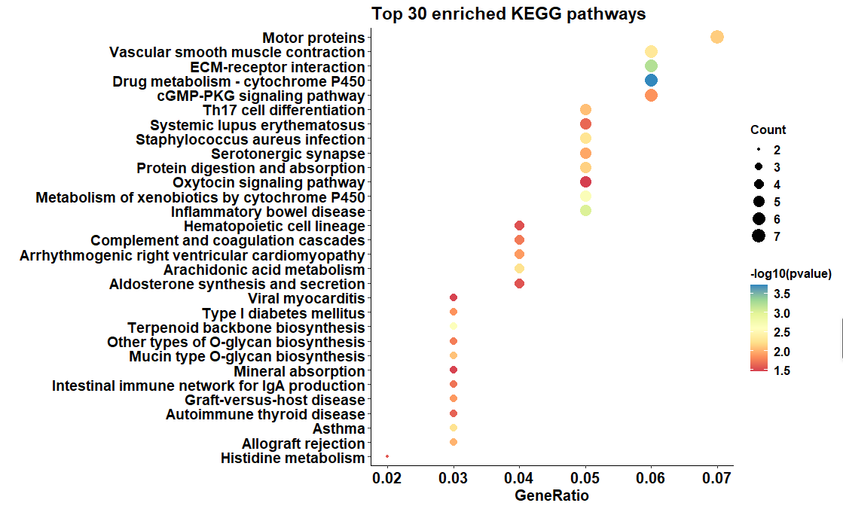
Figure 2
A GO分析
B KEGG的图
DOWN
Notes:
motor protein

Slide 10
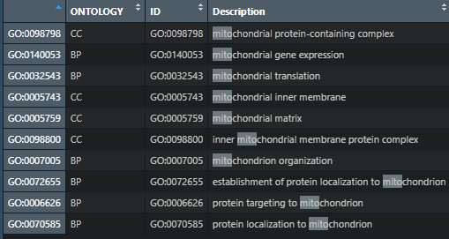
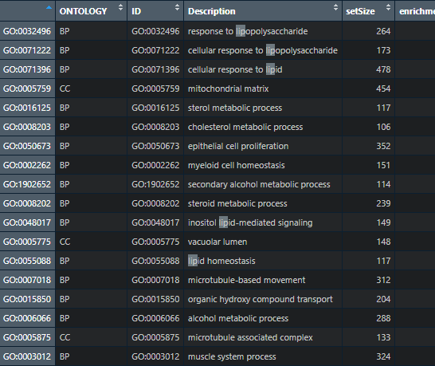
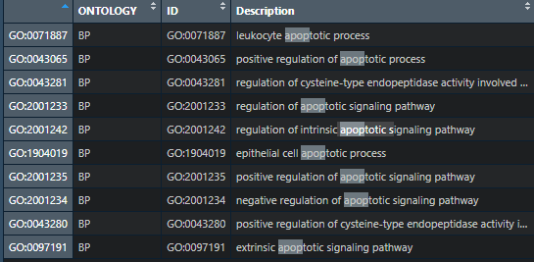
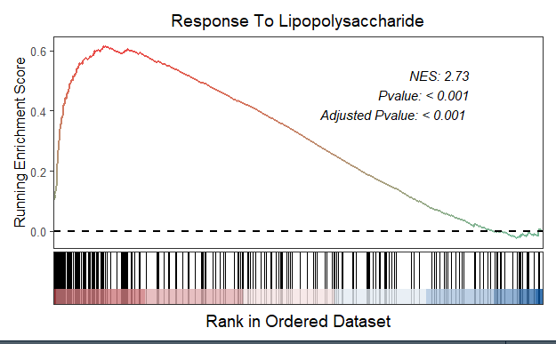
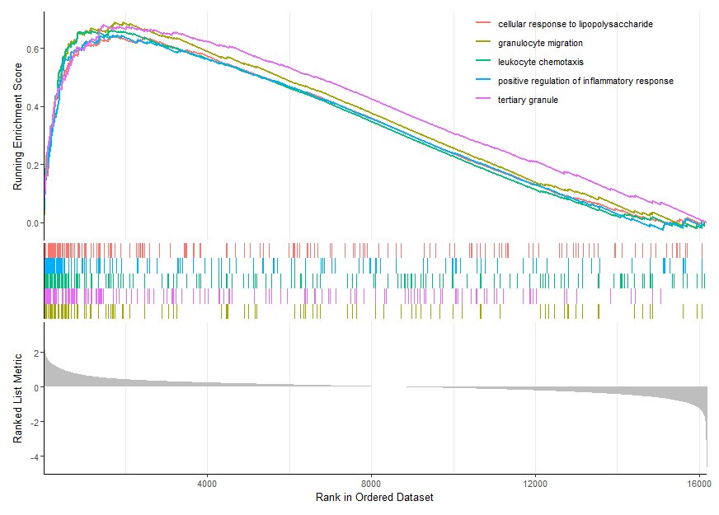
C 俊俊的GSEA以及与自噬，脂代谢相关通路的GSEA
Figure 2
Notes:
GSEA 我们需要探索自噬相关通路和脂代谢相关通路

Slide 11
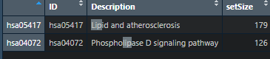
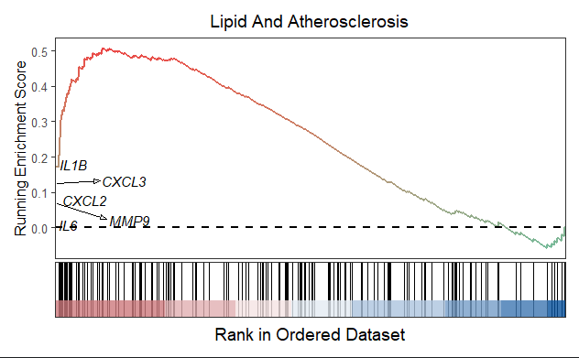
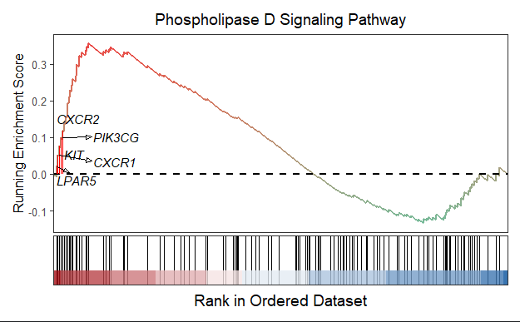
Figure 2
Notes:
lipid adn atherosclerosis
phospholipase D singaling pathway

Slide 12
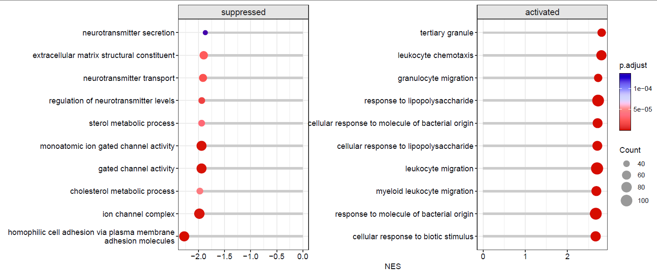
GO gsea
Figure 2

Slide 13
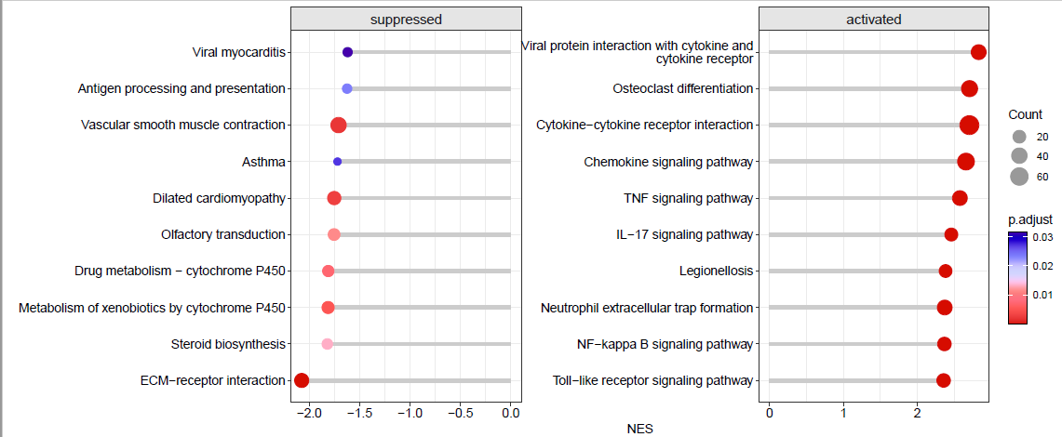
KEGG GSEA
Figure 2

Slide 14
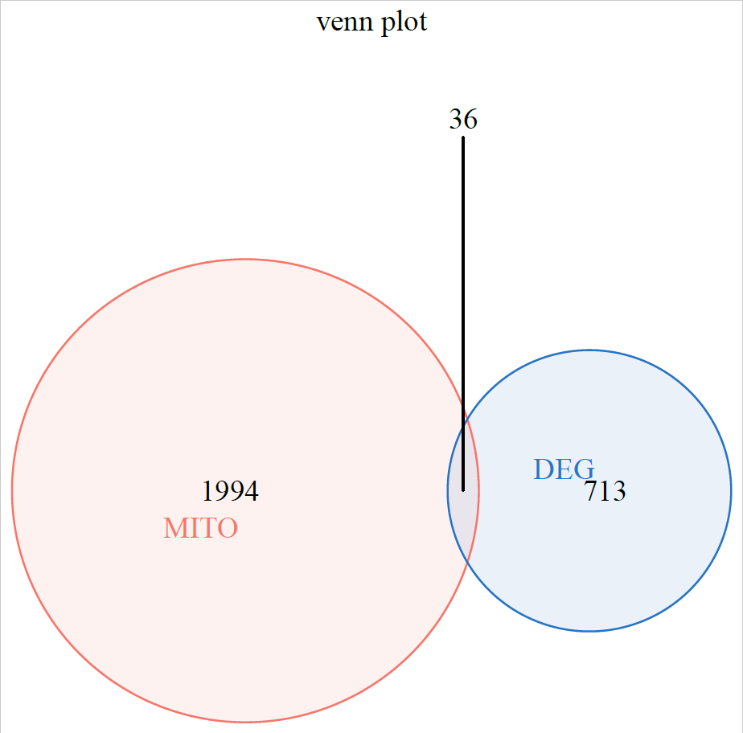
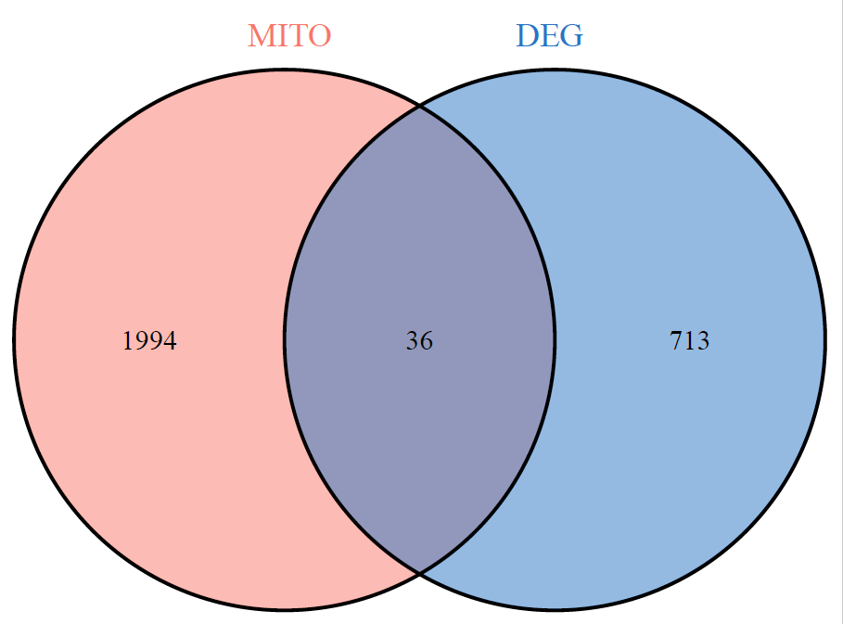
Figure 3
A 和mitoCarta 3.0 交出来的36个基因的热图
B PPI 网络图
C top 10 hub genes

Slide 15
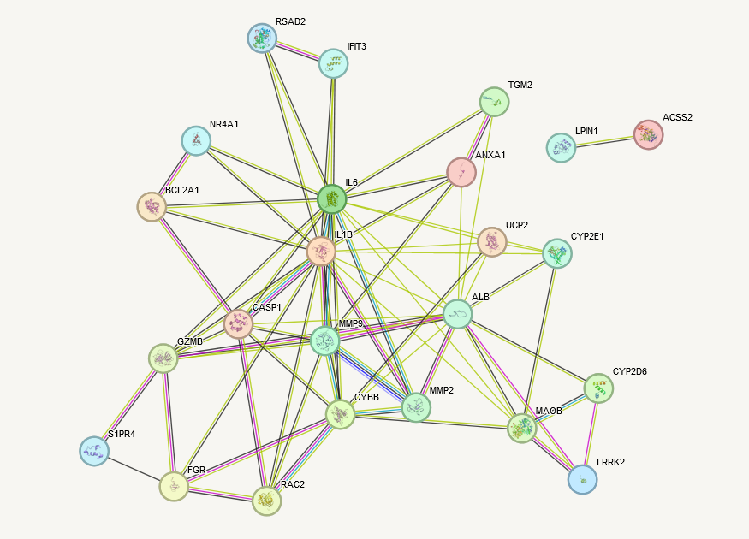
Figure 3
Notes:
KEGG左上调，右下调

Slide 16
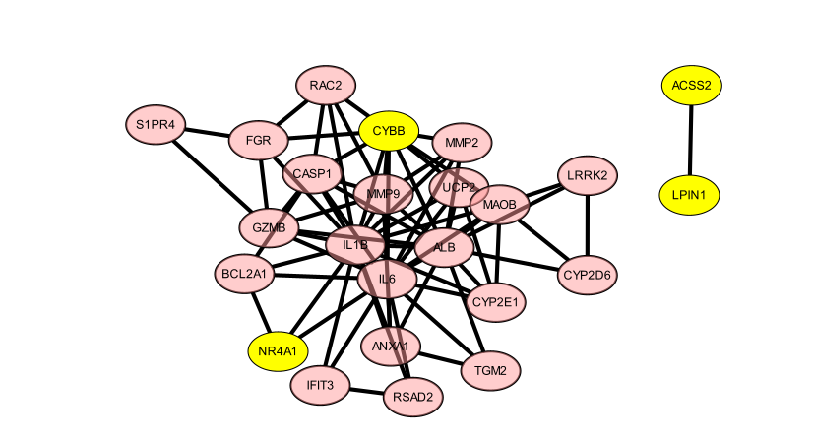
Notes:
放机器学习筛选出来的几个图

Slide 17
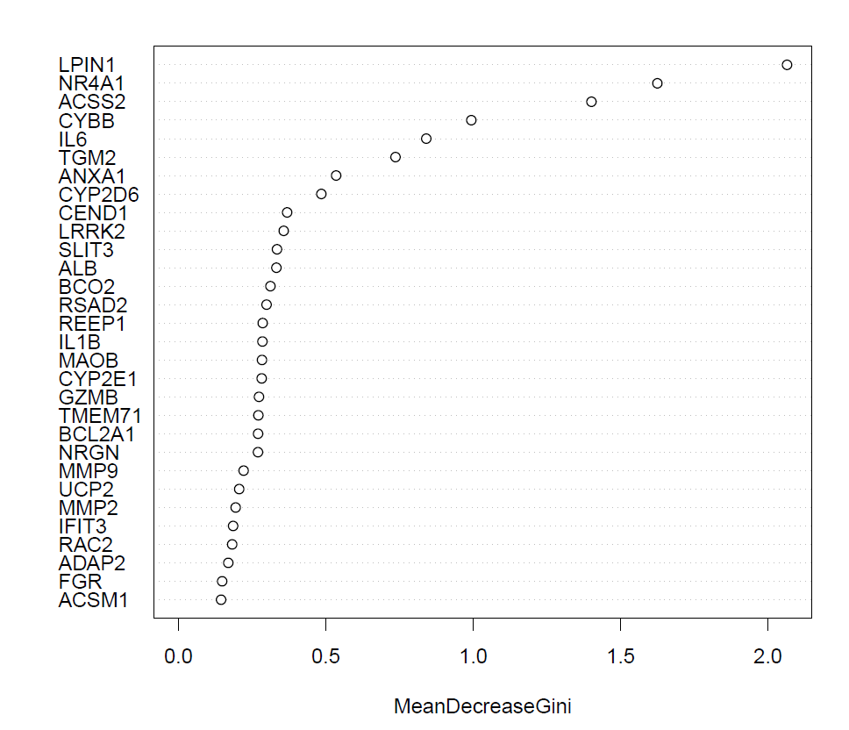
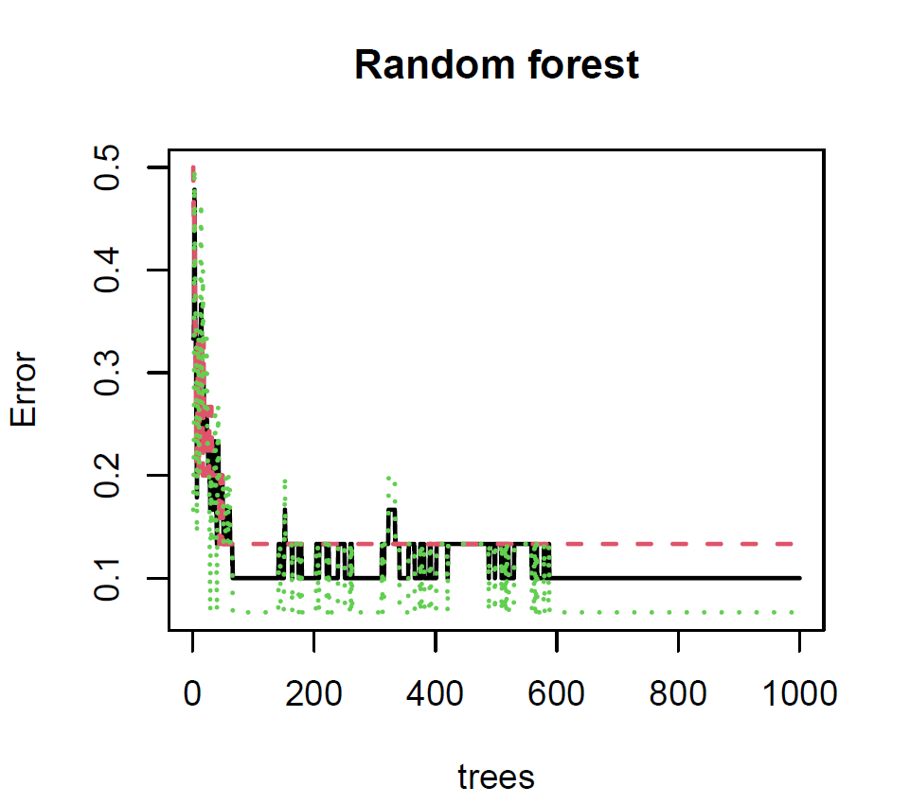
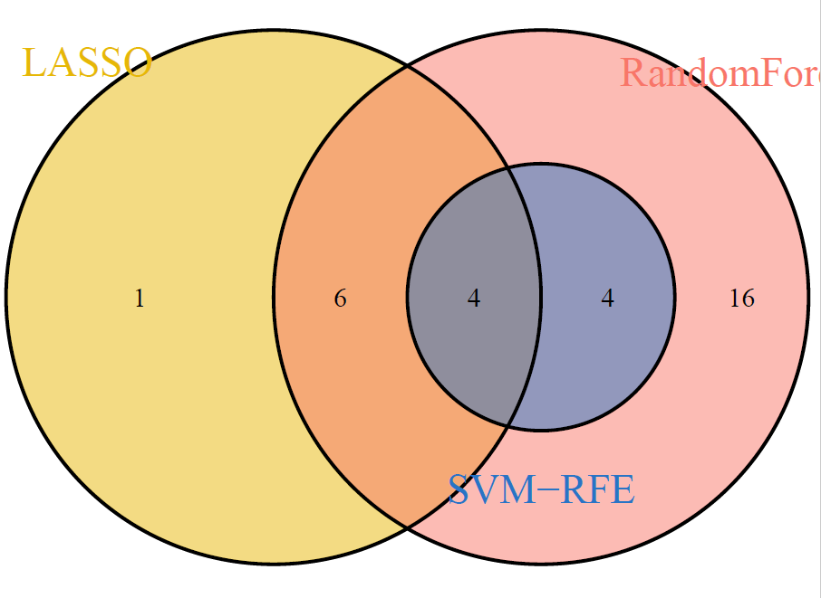
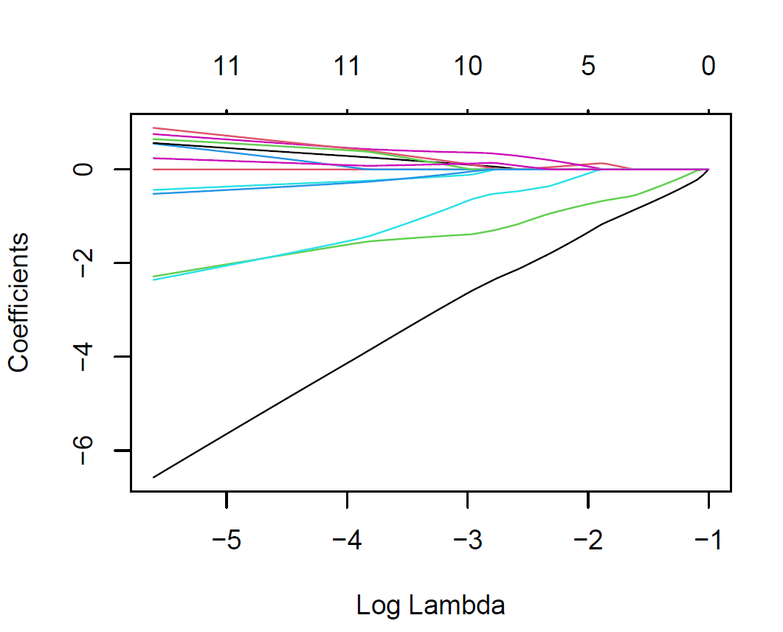
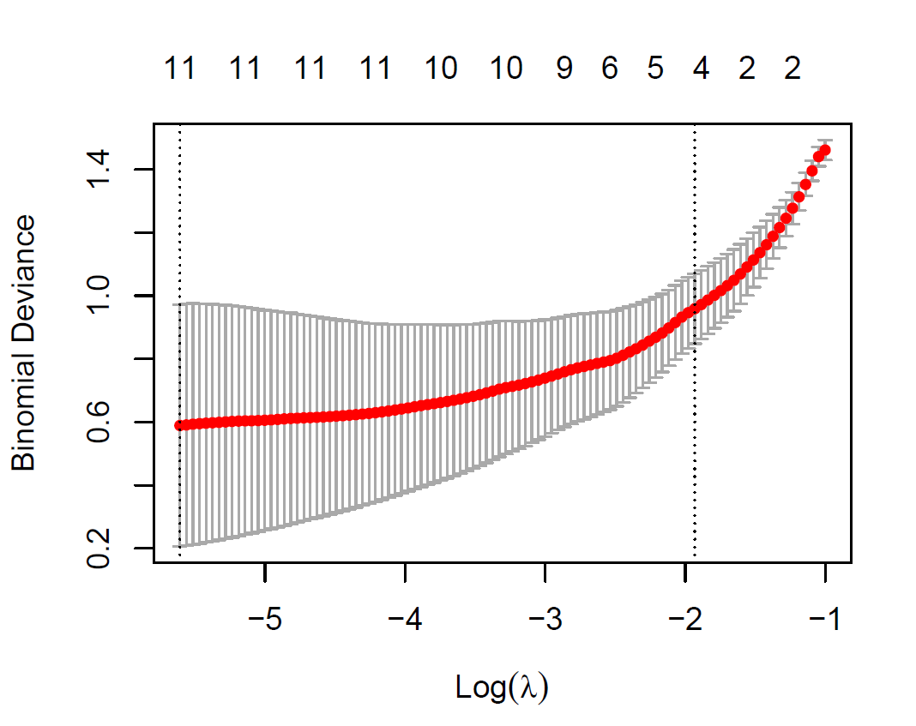
Figure 4 机器学习的图

Slide 18
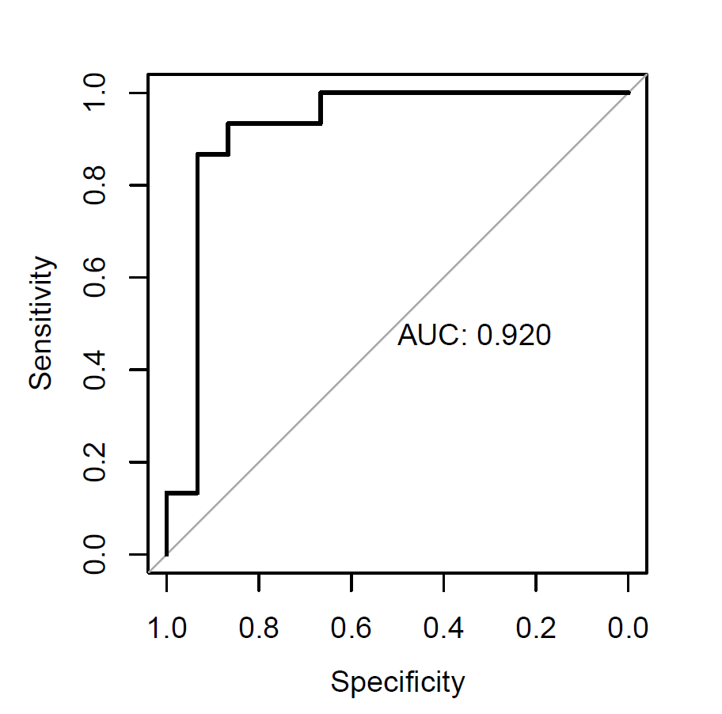




Figure 4 机器学习的图
ACSS2
CYBB
LPIN1
NR4A1

Slide 19


Figure 4 机器学习的图
XGBOOST

Slide 20

Figure 4 机器学习的图
Notes:
上面两个是lasso，下面两个是随机森林; 放附图

Slide 21
Notes:
放机器学习筛选出来的几个图

Slide 22


Figure 5 免疫浸润的结果

Slide 23




Figure 5 免疫浸润的结果

Slide 24

Figure 5 免疫浸润的结果
LPIN1
Notes:
LPIN1 ， IL6， ATG5，HO-1; 还有文章的methods部分参考Na, Z., Guo, W., Song, J. et al. Identification of novel candidate biomarkers and immune infiltration in polycystic ovary syndrome. J Ovarian Res 15, 80 (2022). https://doi.org/10.1186/s13048-022-01013-0 写完；scmetabolism

Slide 25

5个基因和免疫细胞的关系
cibersort

Slide 26


Slide 27
后面再想想

Slide 28

ACSS2
IL6
LPIN1
CYP2D7
MMP9
ACSM1
CYP2E1
REEP1
HIF3A
UCP2
MAOB
GZMB
BCO2
TGM2
S1PR4
IL1B
NR4A1
BCL2A1
CYP2D6
CYBB
SOX4
ANXA1
MMP2
ALB
ADAP2
CASP1
IFIT3
SLIT3
CEND1
RAC2
RSAD2
DEPP1
NRGN
FGR
LRRK2
TMEM71
Notes:
ACSS2
IL6
LPIN1
CYP2D7
MMP9
ACSM1
CYP2E1
REEP1
HIF3A
UCP2
MAOB
GZMB
BCO2
TGM2
S1PR4
IL1B
NR4A1
BCL2A1
CYP2D6
CYBB
SOX4
ANXA1
MMP2
ALB
ADAP2
CASP1
IFIT3
SLIT3
CEND1
RAC2
RSAD2
DEPP1
NRGN
FGR
LRRK2
TMEM71

